Slide 1
Sets, Tuples, & List Comprehensions
Dr. Emily Hill

Slide 2
Sets & Tuples
Notes:
# tuples (unlike [lists]) can be keys for dictionaries
# tuple = immutable list
#one element tuples need a comma!?!
# can use like enums: one, two, three, four = 1, 2, 3, 4
# lists & dictionaries can't be elements of a set, but tuples & frozen sets can

Slide 3
Tuples & Sets
Tuples are an immutable list, use () instead of []
Like lists & strings support + * in & slicing [:]
Built-in functions: min, max, len
Sets can only hold unique values (use {})
Support len & in
Add, remove, discard, pop, clear
Union (|), intersection (&), difference (-)
Subset (<, <=) & superset (>, >=)
Can convert between with built-in list, tuple, and set functions
Notes:
lists: https://docs.python.org/3.4/library/stdtypes.html?highlight=set#list
tuples: https://docs.python.org/3.4/library/stdtypes.html?highlight=set#tuple
set: https://docs.python.org/3.4/library/stdtypes.html?highlight=set#set
# tuples (unlike [lists]) can be keys for dictionaries
# tuple = immutable list
#one element tuples need a comma!?!
# can use like enums: one, two, three, four = 1, 2, 3, 4
# lists & dictionaries can't be elements of a set, but tuples & frozen sets can
# set: https://docs.python.org/3.4/library/stdtypes.html?highlight=set#set
http://www.learnpython.org/en/Sets
http://www.python-course.eu/python3_sets_frozensets.php

Slide 4
List Comprehensions

Slide 5
functional programming
>>> 'fun' in 'functional'
True
representation via list structures (data)
leverage self-similarity (recursion)
create small building blocks (functions)
Composed together -- to solve/investigate problems.
Functional programming
conceptually concise
vs.
efficient for the computer…
functional
procedural or sequential

Slide 6
Data
[13,14,15]
Functions
sum( )

Slide 7
sum range
def sum(L):
""" input: L, a list of #s
output: L's sum
"""
if len(L) == 0:
return 0.0
else:
return L[0] + sum(L[1:])
Base Case
Recursive Case

Slide 8

sum range
step?
def range(low,hi ):
""" input: ints low and hi
output: int list from low to hi
"""
if low >= hi:
return []
else:
return
excluding hi

Slide 9
sum and range
>>> sum(range(1,101))

Slide 10
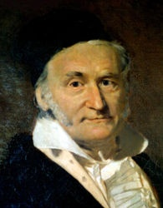
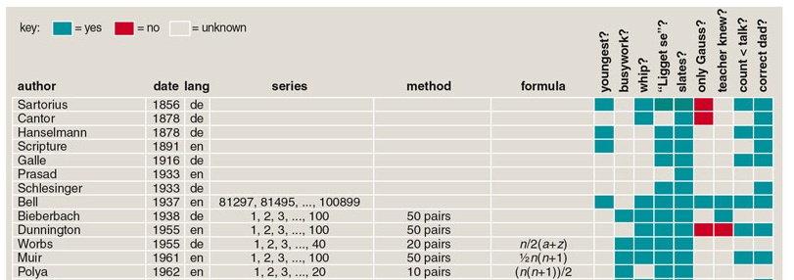
sum and range
1784
>>> sum(range(1,101))
5050
and 100 more…
http://www.americanscientist.org/template/AssetDetail/assetid/50686

Slide 11
Data
[13,14,15]
Functions
sum( )
42
…together

Slide 12
Map
def dbl(x):
return 2*x
>>> map(dbl, [0,1,2,3,4,5])
[0, 2, 4, 6, 8, 10]
def sq(x):
return x**2
>>> map(sq, range(6))
[0, 1, 4, 9, 16, 25]
def is_a(x):
return x == 'a'
>>> map(is_a, 'go away!')
[0, 0, 0, 1, 0, 1, 0, 0]
What does map do?

Slide 13
Map
def dbl(x):
return 2*x
>>> map(dbl, [0,1,2,3,4,5])
[0, 2, 4, 6, 8, 10]
def sq(x):
return x**2
>>> map(sq, range(6))
[0, 1, 4, 9, 16, 25]
def is_a(x):
return int(x=='a')
>>> map(is_a, 'go away!')
[0, 0, 0, 1, 0, 1, 0, 0]
(1) map always returns a list
(2) map(f,L) calls f on each item in L

Slide 14
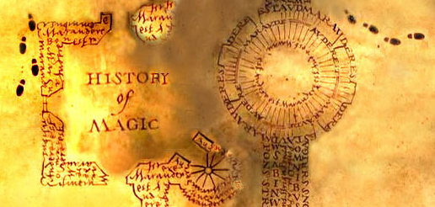
Map, managed!
Map manages recursion for you…
def map(f,L):
""" maps f onto the list L """
if L == []:
return []
else:
return
… and you don't even need the map!

Slide 15
List Comprehensions
The same as map, only better!
this "runner" variable can have any name...
input
>>> [ 2*x for x in [0,1,2,3,4,5] ]
[0, 2, 4, 6, 8, 10]
output

Slide 16
List Comprehensions
The same as map, only better!
this "runner" variable can have any name...
x takes on each value
input
>>> [ 2*x for x in [0,1,2,3,4,5] ]
[0, 2, 4, 6, 8, 10]
and 2*x is output for each one
output

Slide 17

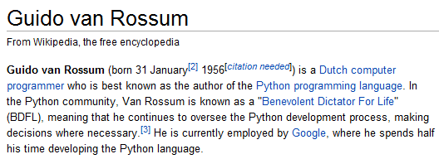
>>> [ 2*x for x in [0,1,2,3,4,5] ]
[0, 2, 4, 6, 8, 10]
List Comprehensions?

Slide 18
>>> [ 2*x for x in [0,1,2,3,4,5] ]
[0, 2, 4, 6, 8, 10]
List Comprehensions?
Funlists
Google maps
Datafuncs!

Slide 19
Try it!
A range of list comprehensions...
Write Python's result for each L.C.:
[ n**2 for n in range(0,5) ]
[ 42 for z in [0,1,2] ]
[ z for z in [0,1,2] ]
[ s[1::2] for s in ['aces','451!'] ]
[ -7*b for b in range(-6,6) if abs(b)>4 ]
[ a*(a-1) for a in range(8) if a%2==1 ]

Slide 20
Try it!
A range of list comprehensions...
Write Python's result for each L.C.:
[ n**2 for n in range(0,5) ]
[ 0, 1, 4, 9 ]
[ 42 for z in [0,1,2] ]
[ z for z in [0,1,2] ]
[ 42, 42, 42 ]
[ 0, 1, 2 ]
[ s[1::2] for s in ['aces','451!'] ]
[ -7*b for b in range(-6,6) if abs(b)>4 ]
[ 42, 35, -35 ]
[ a*(a-1) for a in range(8) if a%2==1 ]

Slide 21
Create your own LCs
input
>>> [ _______ for x in range(4) ]
[0, 14, 28, 42]
output
input
>>> [ _____________ for c in 'igotit' ]
[True, False, False, False, True, False]
[ 1, 0, 0, 0, 1, 0 ]
output
What about this?

Slide 22
LCs vs. raw recursion
def len(L):
if L == []:
return 0
else:
return 1 + len(L[1:])
len(L)
scrabble score!
def sScore(s):
if len(s) == 0:
return 0
else:
return letScore(s[0]) + \
sScore(s[1:])
sScore(s)
def sajak(s):
if len(s) == 0:
return 0
else:
if s[0] not in 'aeiou':
return sajak(s[1:])
else:
return 1+sajak(s[1:])
# of vowels
8 lines! Aargh!
sajak(s)

Slide 23
Using LCs
'cs5'
def
len(L):
LC = [1 for x in L]
print LC
return sum( LC )

Slide 24
"One-line" LCs
'cs5'
def
len(L):
LC = [1 for x in L]
print LC
return sum( LC )
def
len(L):
return sum([1 for x in L])

